Slide 1
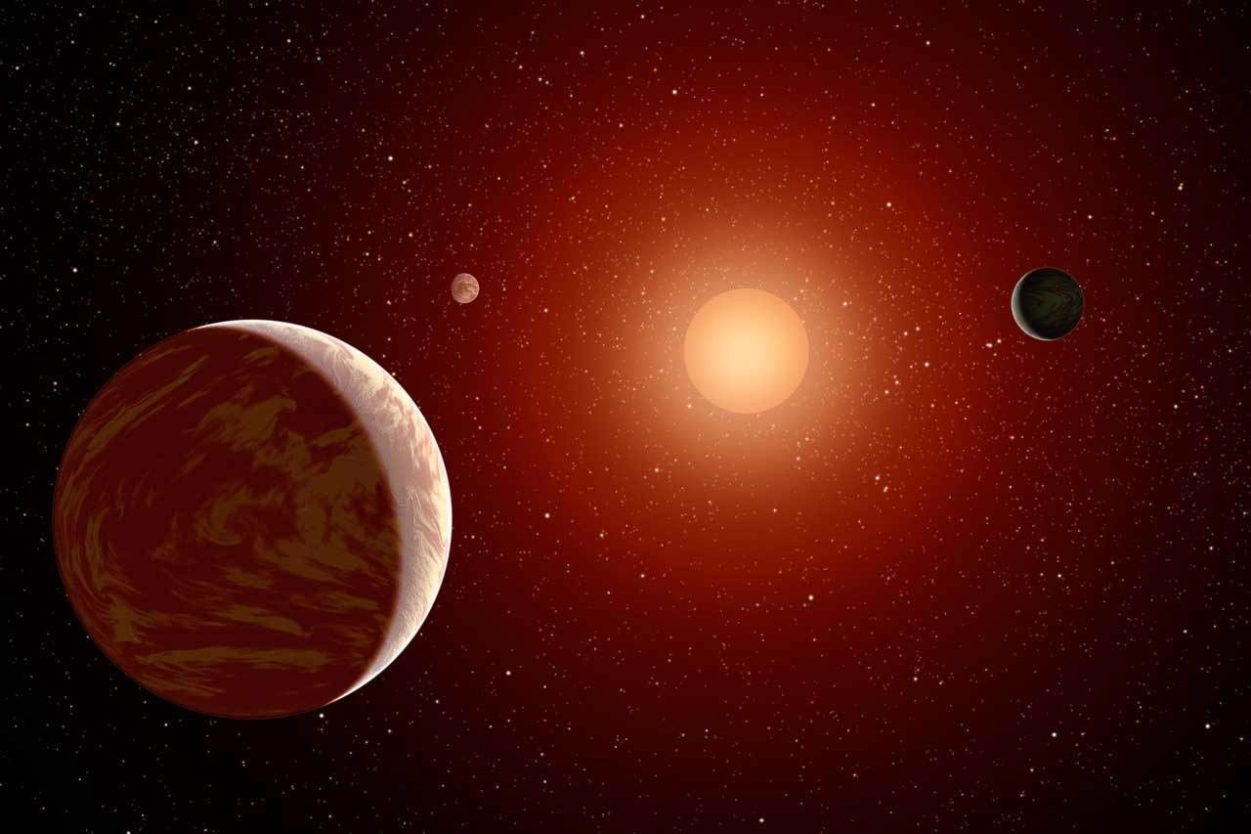
Exoplanet Data Explorer and Calculating Detection Signal of
Different Methods
January 2024
Seth Ketchem, Raihan Malik, and Mitchell Weber
Group 8

Slide 2
Motivation
Further our understanding of
strengths and limits of detection methods
See if/how earth-like planets could be detected

Slide 3
How have we detected exoplanets thus far?
Methods
Transit
Flux difference in the star’s light from passing planet
Radial Velocity
Wobble from planet’s gravity
Doppler Effect causes a shift in the star’s light
Microlensing
Light from different star bent by gravity
Direct Imaging
Resolving the image of the planet by blocking the image of the star
There are a few main detection methods
We plotted currently known exoplanets by these different methods (and more)

Slide 4
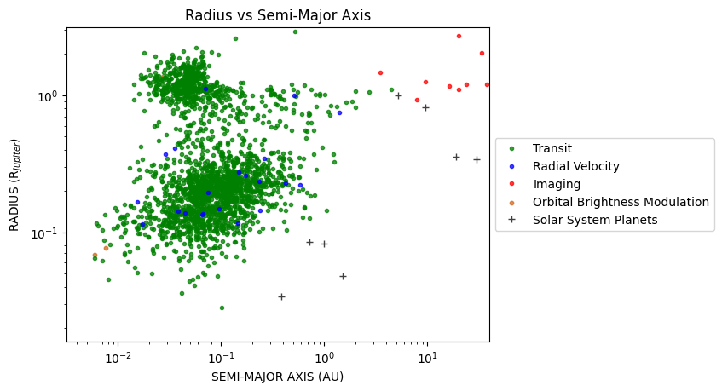
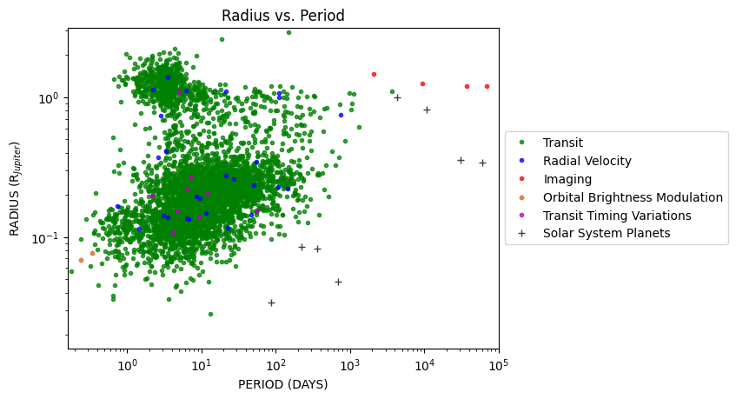
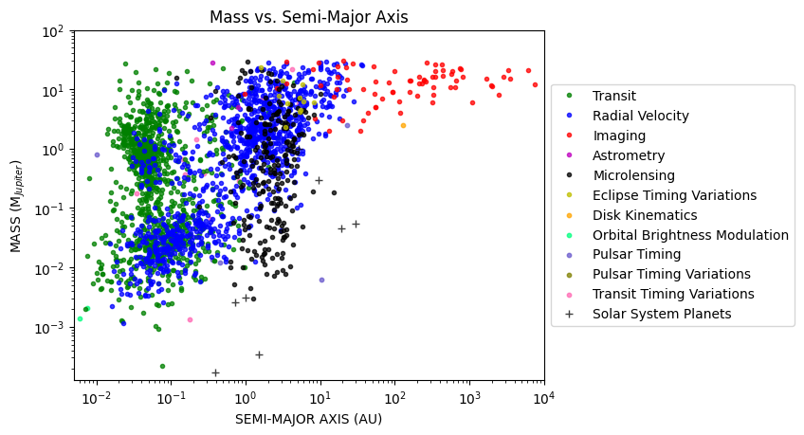
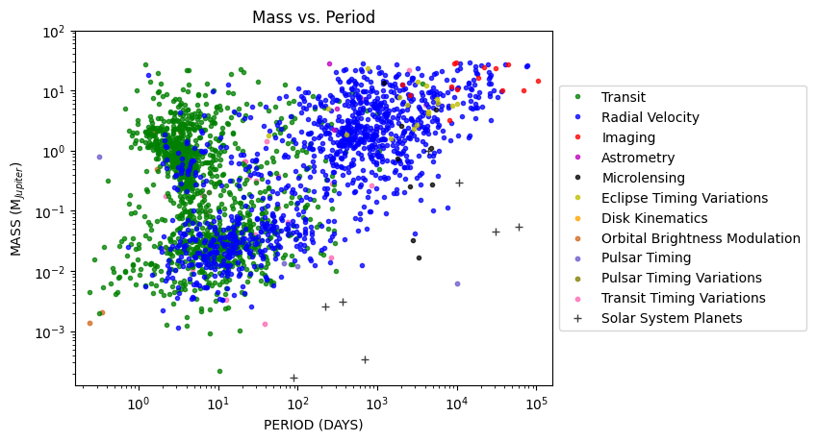
Plots
What do you notice?
These should stick out right away:
Transit is sensitive to
radius
Radial Velocity is sensitive to mass
Imaging is sensitive to
mass and semi-major axis
Microlensing is sensitive to semi-major axis
but in a different way

Slide 5
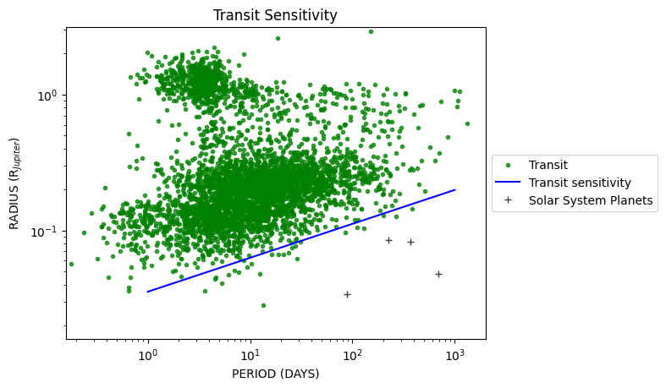

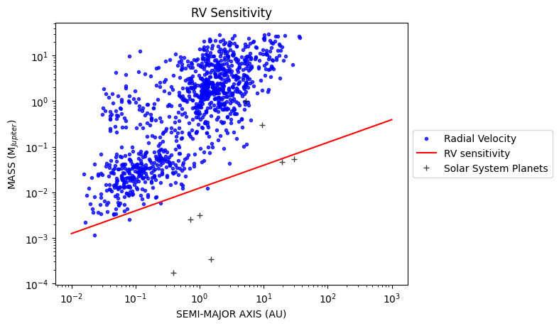

But what are the sensitivities exactly?
Here we analyze the sensitivity curves of transit and radial velocity.
Notice the gaps that are not associated with the sensitivity limits!

Slide 6



So, how would these methods work for an Earth-like planet?
Transit ~0.000934
Radial Velocity ~0.516 m/s
Direct imaging ~5.45e-08
We tested the detection signals for an Earth-like planet orbiting an M-type star (the most common star type).

Slide 7
Do these results match state-of-the art detection sensitivities?
Results
Transit ~0.000934
or 0.09%
Radial Velocity ~0.516 m/s
Direct imaging ~5.45e-08
Faintly detectable
On the edge of what is detectable
Not detectable
Could we detect an Earth-like planet orbiting an M-type star?

Slide 8
Conclusions
Transit
Planets with large radii
Shorter orbital periods easier to detect
Way to observe the Radius of an exoplanet
Radial Velocity
Larger planets that orbit closer to their star
Way to observe mass of an exoplanet
Direct Imaging
Planet must be large enough
Star + Planet must be far enough away
Less data points
Detection Signals
Earth-like planets give faint signals for all three methods
Transit is best
As state-of-the-art detection gets better, more planets will be detectable close to the sensitivity limit

Slide 9
Questions?
References
[1] NASA. Alien Worlds / Historic Timeline. url: https : / / exoplanets . nasa . gov / alien - worlds /
historic-timeline/#first-planetary-disk-observed. (accessed: 1.28.2025).
[2] Joshua N. Winn. “Exoplanet Transits and Occultations”. In: Exoplanets (2010).
[3] Debra A. Fischer Christophe Lovis. “Radial Velocity Techniques for Exoplanets”. In: Exoplanets (2010).
[4] Ben R. Oppenheimer Wesley A. Traub. “Direct Imaging of Exoplanets”. In: Exoplanets (2010).
[5] B. Scott Gaudi. “Microlensing by Exoplanets”. In: Exoplanets (2010).
Division of work
Coding - Seth Ketchem, Raihan Malik
Paper - Raihan Malik
Presentation - Seth Ketchem, Mitchell Weber

